Slide 1

ATP Tennis Dataset Analysis
By: Ryan Nguyen
Notes:
20 seconds

Slide 2

Introduction
I have been learning how to play tennis recently, so that’s why I picked this dataset!
Each row is a match from ATP 2023 (Dataset)
I wanted to analyze the Tennis Dataset showing Matches in 2023
We’ll color the embedding by surface to interpret structure
Goal: AE learns compact representation of match statistics and see whether latent space captures meaningful structure – especially differences by court surface
Notes:
1 min 10 sec

Slide 3
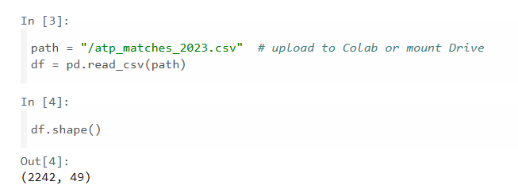
About Dataset
2242 matches
49 raw columns
Includes tournament metadata and match stats
After preprocessing, autoencoder input became 61 features

Slide 4
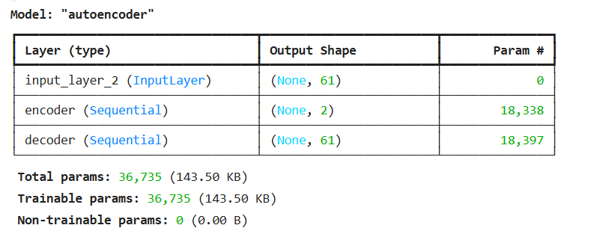
EDA and Preprocessing
Dataset mostly Hard courts, Clay, then Grass
Handled missing values for numeric and categorical
Categorical features were one-hot encoded
Numeric features were standardized
Notes:
Hard is 1040, Clay is 878, Grass is 324
Used Median Imputation for Numeric, Most-frequent imputation for Categorical
Train/test split, trained autoencoder to reconstruct input features using MSE (scaling matters for large numeric ranges)

Slide 5
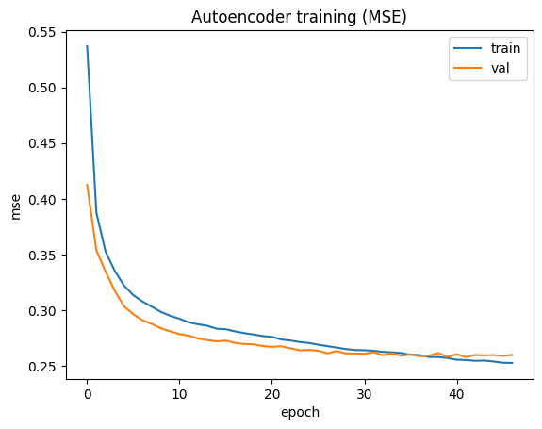
Autoencoder architecture and Training Curve
Dense autoencoder for tabular data (61)
Compress data down to 2-dim bottleneck
Total parameter count = 36k
I chose Latent Dimension 2
Both curves drop quickly + plateau
No major overfitting
Evaluate reconstruction quality
Plateau Here
Notes:
Latent embedding space
2 dimensions back to 61 to reconstruct original feature vector
Small to train quickly, flexible to learn structure
Visualize embedding without needing PCA or UMAP
Stable representation
Training and Validation curves stay close, not major overfitting – model generalizes similarly on unseen matches
Train and use reconstruction error as an anomaly score

Slide 6
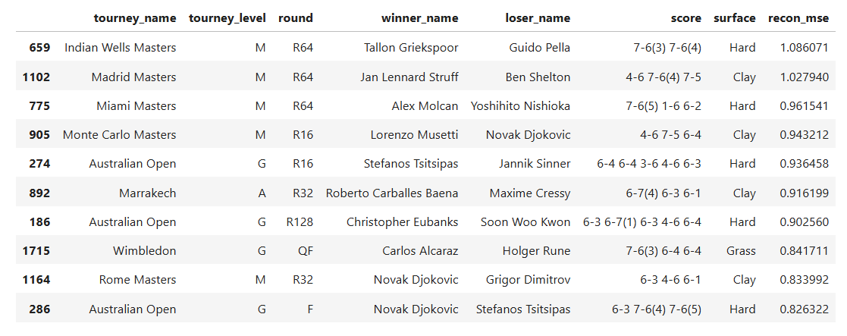
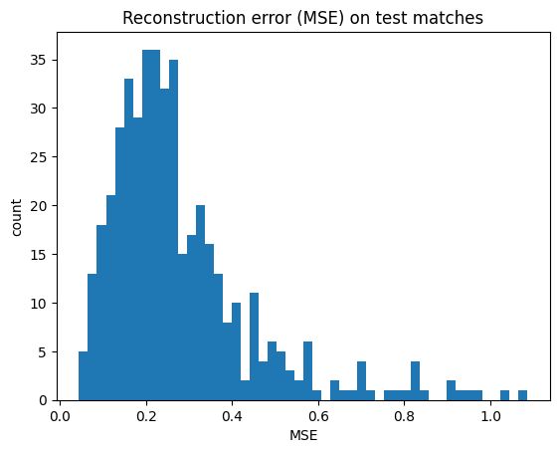
Reconstruction and Latent Embedding Plot
Reconstruction error is computed as Mean Squared Error
Histogram shows most matches reconstruct with low error
High-error matches have less typical statistical profile than AE
Reconstruction error gives quantitative way to rank least normal matches
Notes:
Between original feature vector and reconstructed vector
Clear right tail = small set of matches with much higher MSE
Top matches by reconstruction error – candidates for unusual match profiles (not bad data) – match dynamics, extreme stat combinations, edge case
Learned Representation

Slide 7
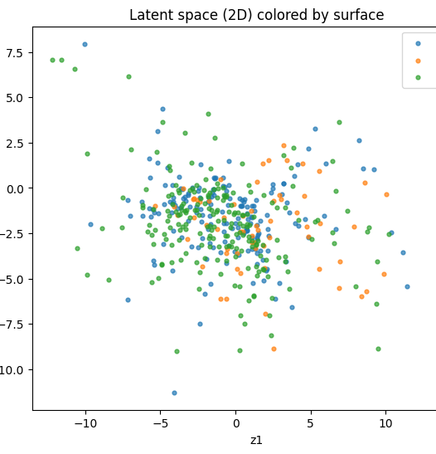
Latent Space Plot (2D) colored by surface
“What can we see?”
2D latent space learned by encoder
Some separation, but substantial overlap
Shared patterns across surfaces, some more concentrated
Overlap informative with statistically similar matches
Notes:
Each point is a match, colored points by surface
Between surfaces
Match stats not perfectly surface-specific - autoencoder capture some surface-related structure
Features can not fully encode surface-dependent style – can increase latent dimension above 2, visualize with PCA/UMAP

Slide 8
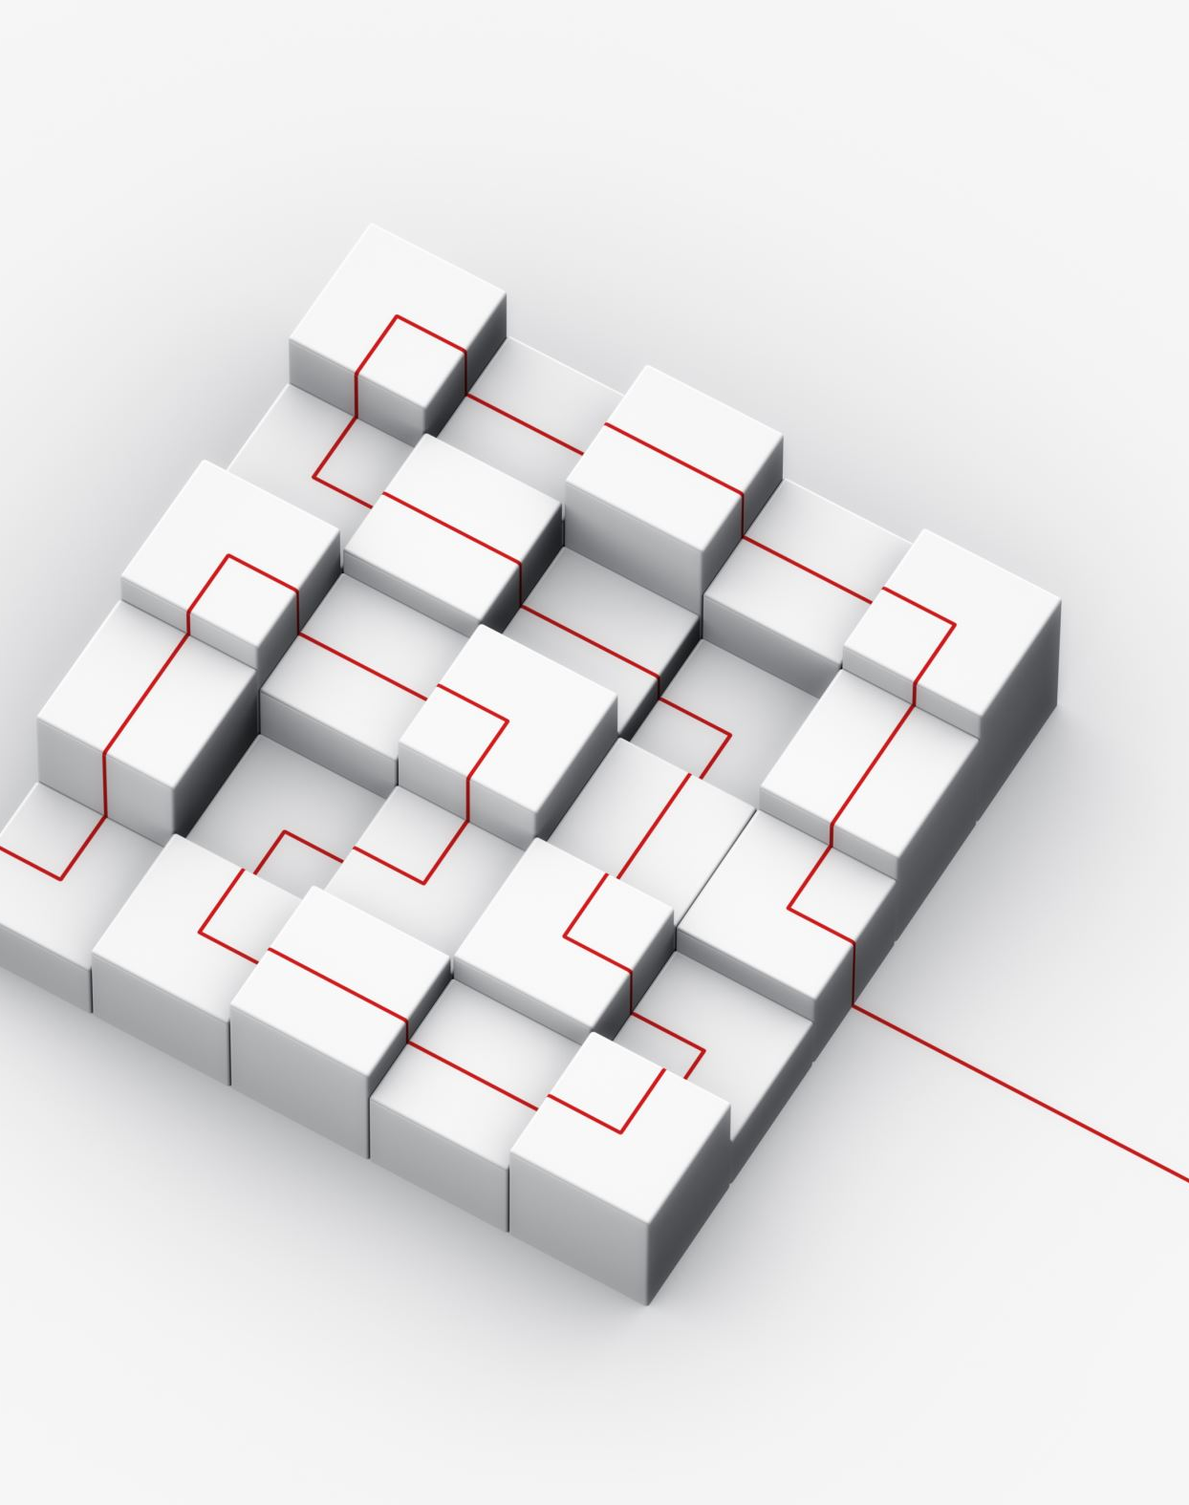
Conclusion
Trained a dense autoencoder on ATP 2023 match data using MSE reconstruction. Model learned a 2D latent representation showing partial structure by surface, and reconstruction error provides a natural anomaly score to identify unusual match profiles.
Next Steps?
Notes:
Try latent_dim = 8 or 16 and reduce to 2D for visualization
Use latent codes as features for downstream surface classification model
Engineer features like serve dominance ratios or break-point efficiency to amplify style differences
MSE is continuous reconstruction of standardized features
Model reaches limit of how well 2D bottleneck can reconstruct 61 features
Training is unsupervised, labels interpret latent space, embedding could be used for classification downstream

Slide 9

Questions? Link to Code

